Slide 1
Waste Stream Management for Drinking Water Treatment
Team Atlantis
Azhir Barodawala, Congyue (Vicky) Wu & Mike Zarecor
Notes:
With a focus on waste stream from fluoride plants

Slide 2

Goals
Fluoride Removal
Nalgonda Technique
AguaClara Research Team
Waste Stream Treatment
Waste Reduction
Residual Treatment
Notes:
With Fluoride Treatment you need just the right amount. Not too much (fluorosis), not too little (tooth decay), just right (1.5 mg/L)
Goal is to understand the conventional and aguaclara method to treat fluoride concentration.
Use this knowledge to come up with a way to treat the waste stream obtained from the fluoride treatment.
Possible solutions for the aguaclara plants and the research required.

Slide 3
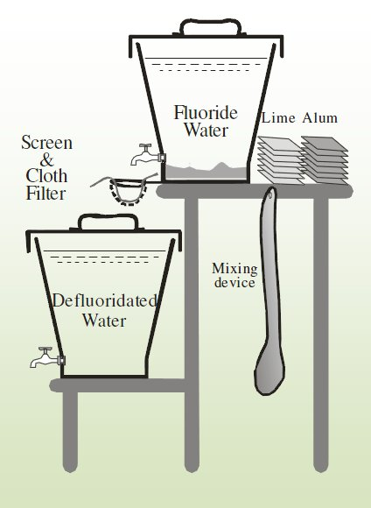
Fluoride Removal - Nalgonda Technique
The Good - Simple POU method of Fluoride Treatment - Low cost treatment
The Bad - Large amounts of Alum required - Difficult to regulate the pH using lime - Sludge generated in the 1st bucket has high concentration of Fluoride with no treatment method
Notes:
Open Lime & alum packet,mix thoroughly for a 1-2 minutes (rapid mix), then slowly - 5 mins (flocculation) and then let it settle (1 hr), and then water is drained into 2nd bucket which is ready to drink.
Used in India and Tanzania

Slide 4
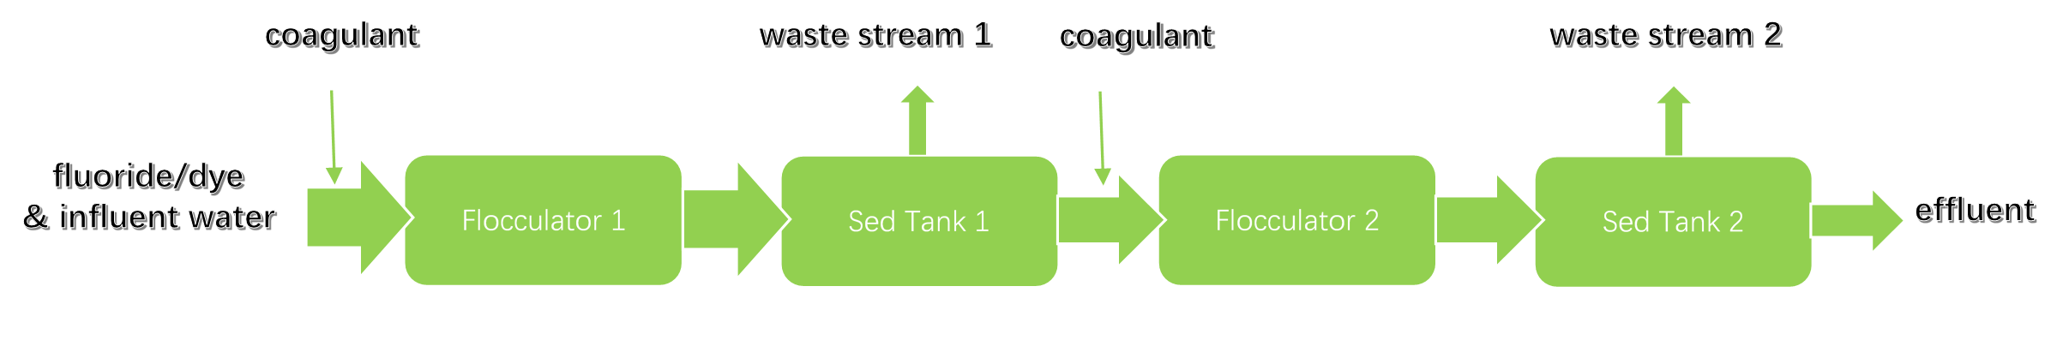
Fluoride Removal - AguaClara
a two-stage coagulation flocculation sedimentation process

Slide 5
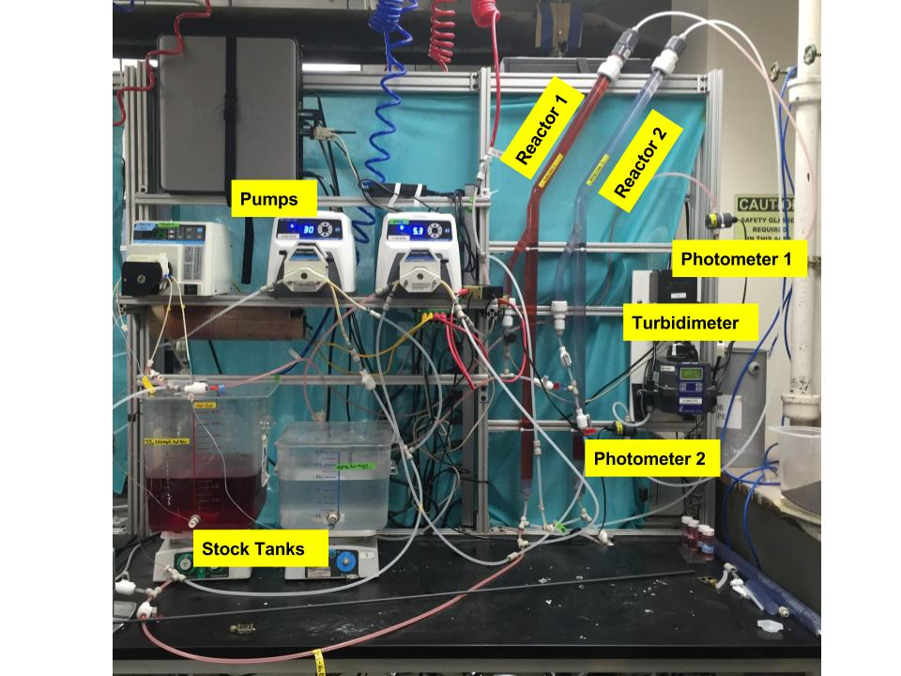
Fluoride Removal - AguaClara
bench scale setup

Slide 6
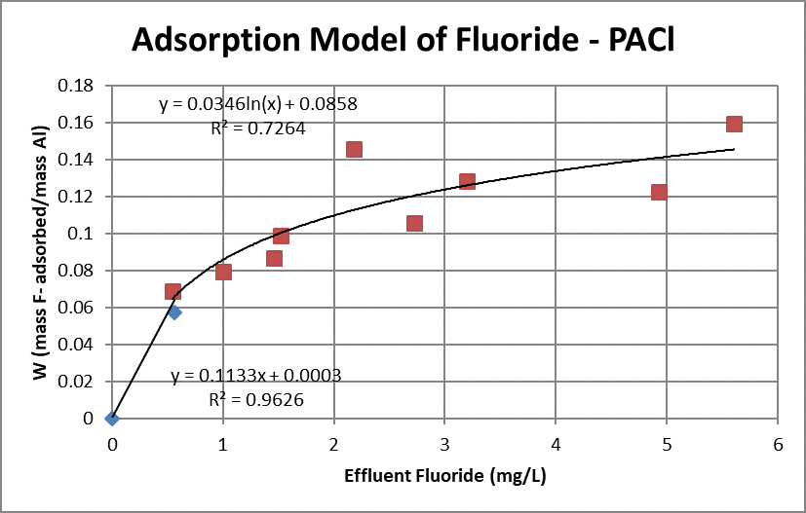
Fluoride Removal - AguaClara
use PACl more efficiently
lower effluent F concentrations
Langmuir isotherm observed

Slide 7
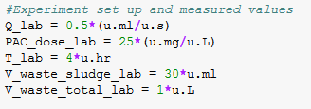
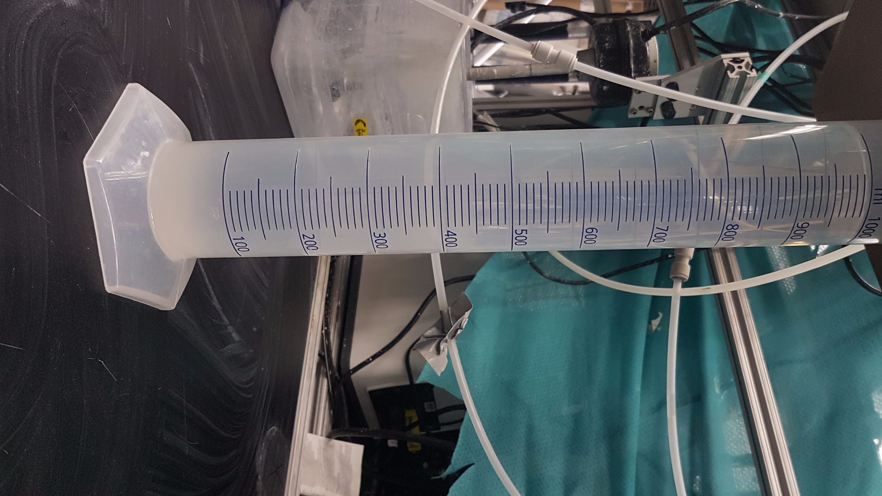
Experimental Analysis

Slide 8
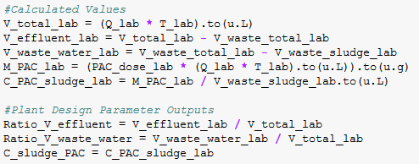
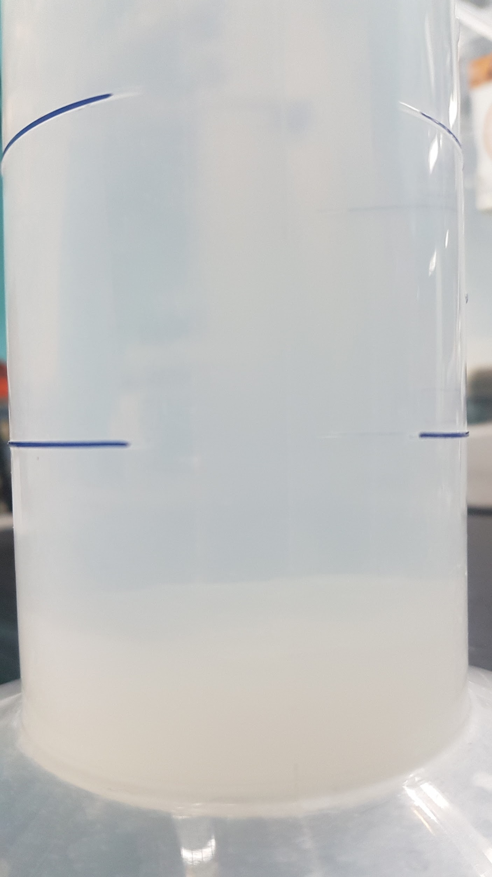
Experimental Analysis
The ratio of effluent volume to total volume is 0.8611 dimensionless
The ratio of waste water volume(recycle) to total volume is 0.1347 dimensionless
The PAC concentration of the sludge 6 gram / liter

Slide 9
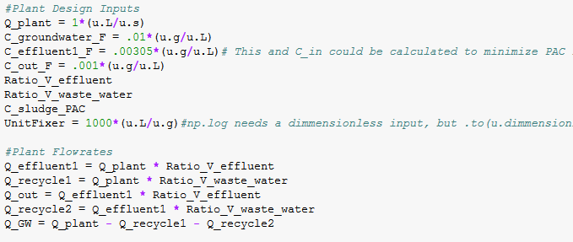
1 L/s Plant Design Inputs and Calculated Flow Rates

Slide 10
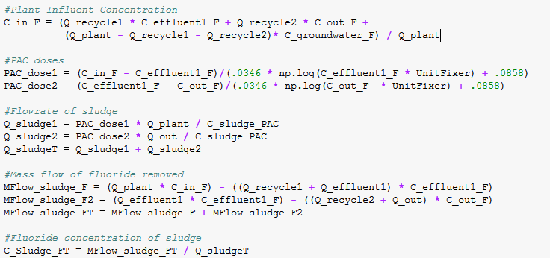
1 L/s Plant Calculations

Slide 11
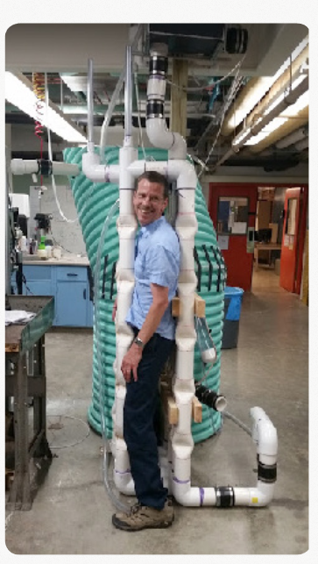
Plant Effluent and Waste Streams
The effluent flow rate is 0.7415 liter / second
The fluoride concentration of the effluent is 0.001 gram / liter
The sludge flow rate is 0.009612 liter / second
The aluminum concentration of the sludge is 6 gram / liter
The fluoride concentration of the sludge is 0.7024 gram / liter

Slide 12
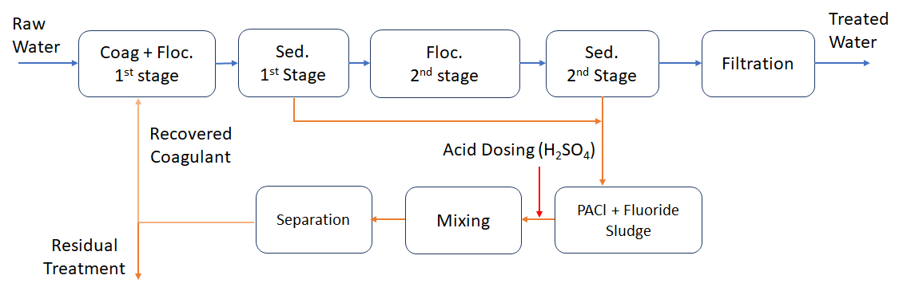
Waste Reduction - Acid Recovery
Notes:
Explain Flowsheet
Though there are many other ways of reducing the waste generated - Recycling backwash from filters, maintaining an optimum pH, using less chemicals and reuising the chemicals

Slide 13
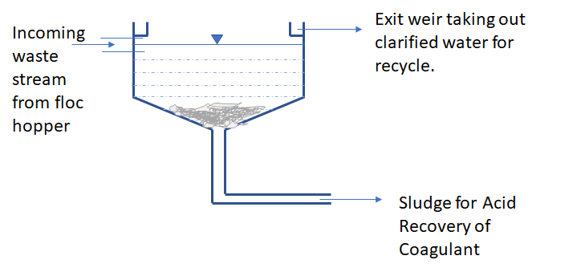
Waste Reduction - Acid Recovery
Notes:
Method for separation of sludge from the waste stream. Sludge goes through acid recovery. The clarified water at the top can be recycled to the beginning of the plant.
The sludge can either go to acid recovery and then drying or directly drying. We need to estimate the the amount of aluminium that needs to be recovered and its feasibility.

Slide 14
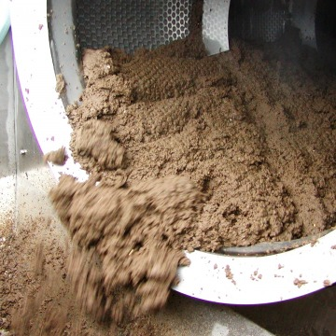
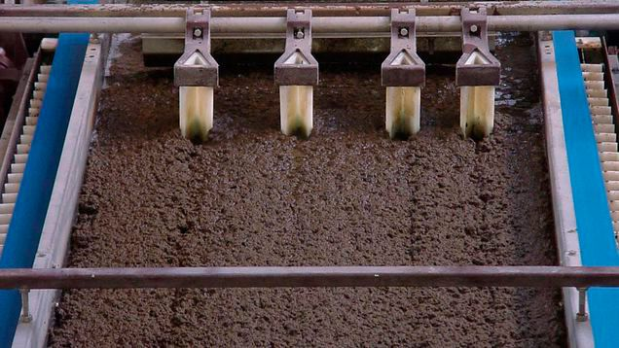
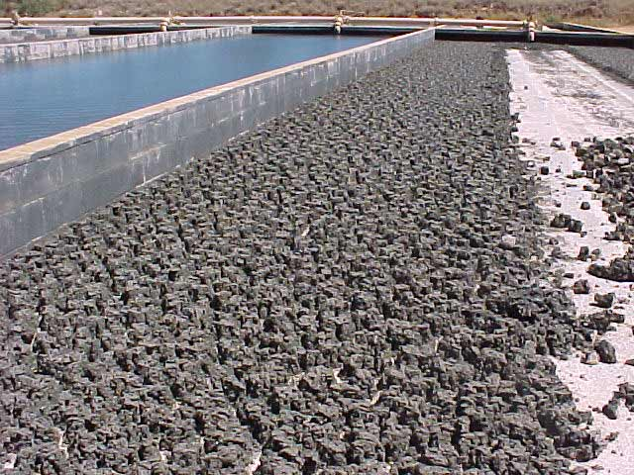
Residual Treatment
Thickened Sludge
5-6% solids
4-40 J/L
Dewatered Sludge
20-25% solids
3600-36000 J/L
DriedSludge
95% solids
3.6*10^5 J/L
Notes:
Basics of each process - increasing order of solids concentration and energy requirement.
Methods for thickening - Gravity, Dissolved Air Floatation, Centrifugation
Methods for Dewatering - Filter Press (belt and vacuum)
Methods for Drying - Solar Drying

Slide 15
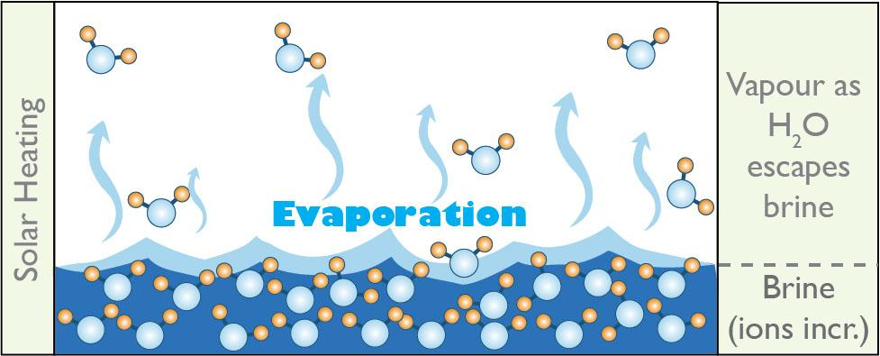
Solar Evaporation for Separating Solids
Evaporation commonly used to remove liquids from sludge in wastewater treatment
Solar evaporation (minimize labor and fuel requirement)
Works best at low latitudes (sunlight duration and intensity ↑↑↑ & relative humidity and rainfall ↓↓↓ )

Slide 16
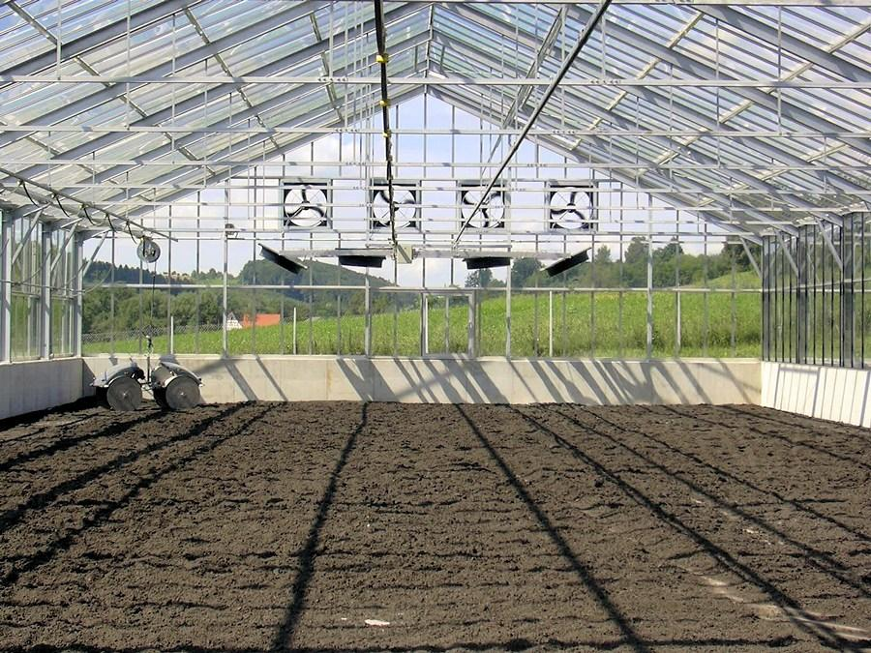
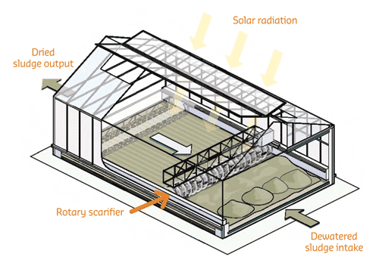
Solar Drying Bed for Sewage Sludge
Thermal drying, achieve > 90% dry solids content (DS) in sludge
However, requires high amount of energy and expensive
A greenhouse solar dryer (GSD) can be a cost-effective substitute

Slide 17
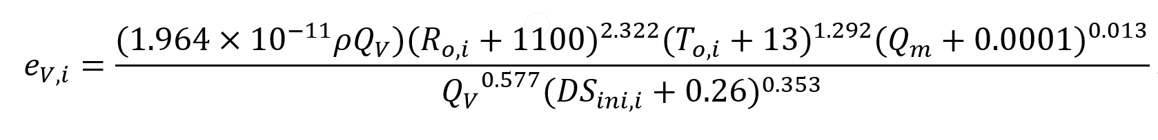
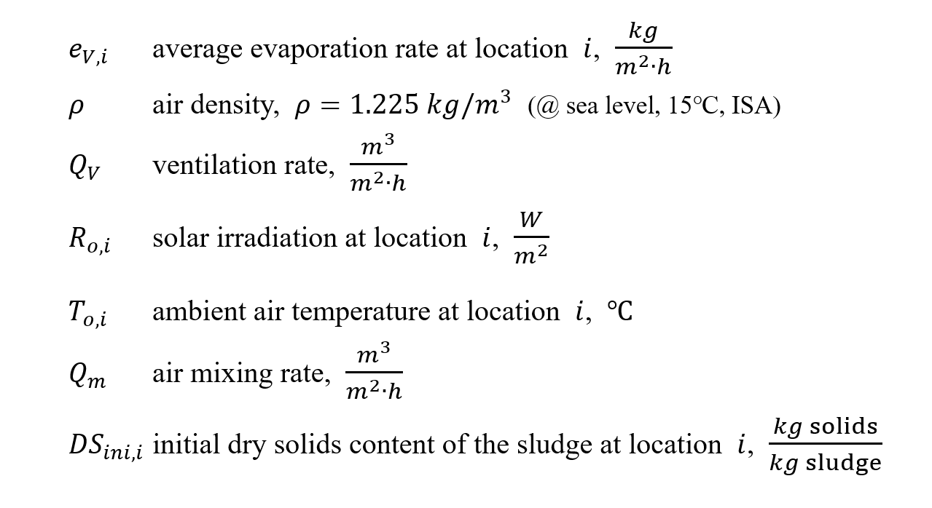
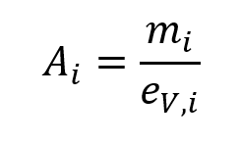
Solar Drying Bed for Sewage Sludge

Slide 18
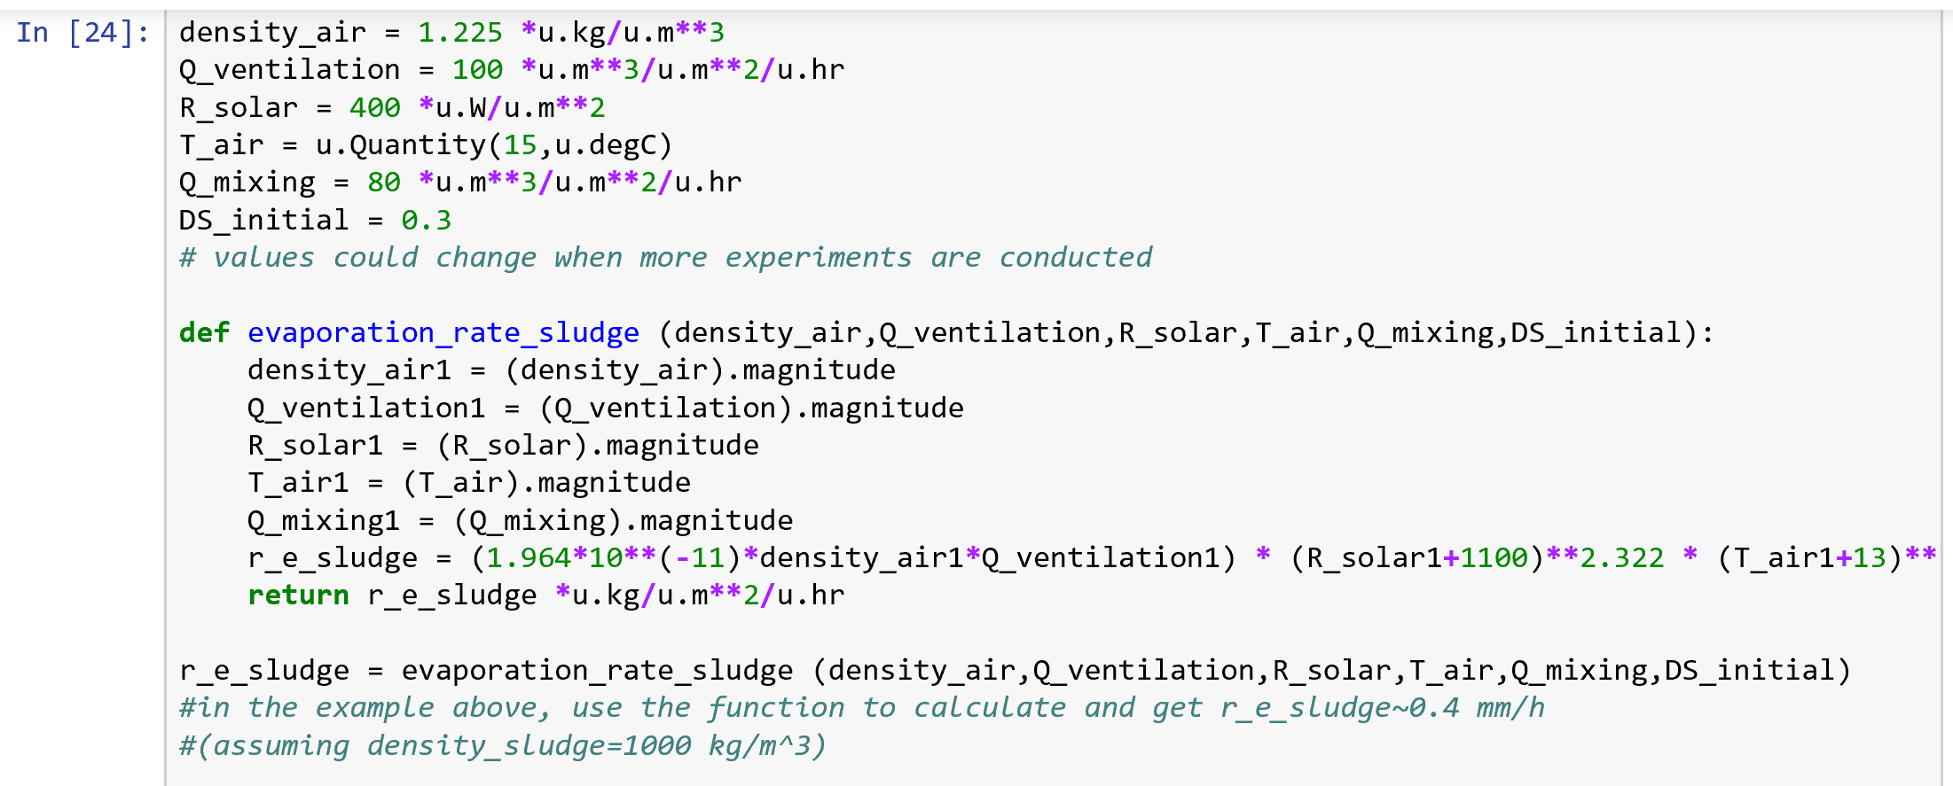
Solar Drying Bed for Sewage Sludge
As a reference for the AguaClara team to calculate stuffs related to Alum-Fluoride combined solids separation process

Slide 19
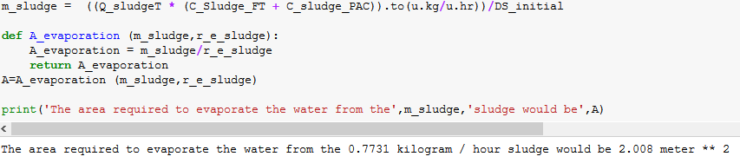
Solar Drying Bed for Sewage Sludge
As a reference for the AguaClara team to calculate stuffs related to Alum-Fluoride combined solids separation process

Slide 20
Conclusion & Recommendations
Recycle the wastewater collected from the sedimentation tanks
Recover the coagulant from the sludge by acidification - Requires research to determine how much Aluminium can be recovered!
Solar Dry the remaining residuals which can then be landfilled.

Slide 21
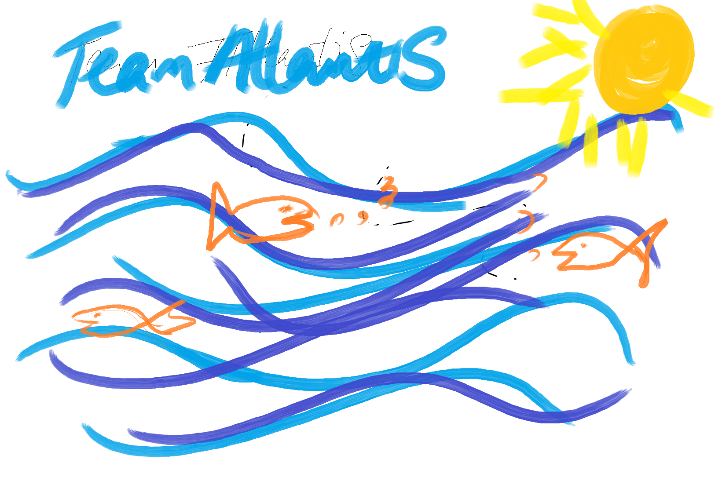
Questions?

